Slide 1


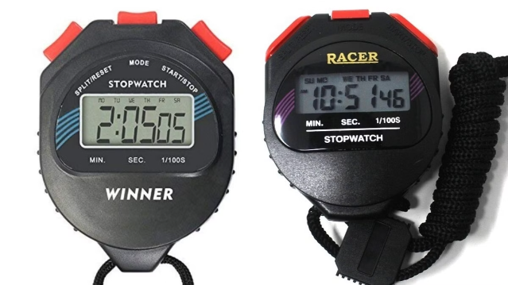
Building a Stopwatch Web Application
Creating a stopwatch web application involves using HTML, CSS, and JavaScript to structure elements, style them, and implement functionality.
by Vaibhavi sahu

Slide 2
HTML Structure
Timer Display
Buttons
Lap Display
Use a div element to display the time, formatted as minutes, seconds, and milliseconds.
Include buttons for "Start," "Pause/Resume," and "Reset" to control the stopwatch functionality.
Create a

Slide 3
GOLD STOPWATCH
00:00:00
<div class="controls"> <button class="buttonPlay"> <img id="playButton" src="https://res.cloudinary.com/https-tinloof-com/image/upload/v1593360448/blog/time-in-js/play-button_opkxmt.svg" /> <img id="pauseButton" src="https://res.cloudinary.com/https-tinloof-com/image/upload/v1593360448/blog/time-in-js/pause-button_pinhpy.svg" /> </button> <button class="buttonReset"> <img id="resetButton" src="https://res.cloudinary.com/https-tinloof-com/image/upload/v1593360448/blog/time-in-js/reset-button_mdv6wf.svg" /> </button> </div> </div> <script src="script.js"></script>

Slide 4

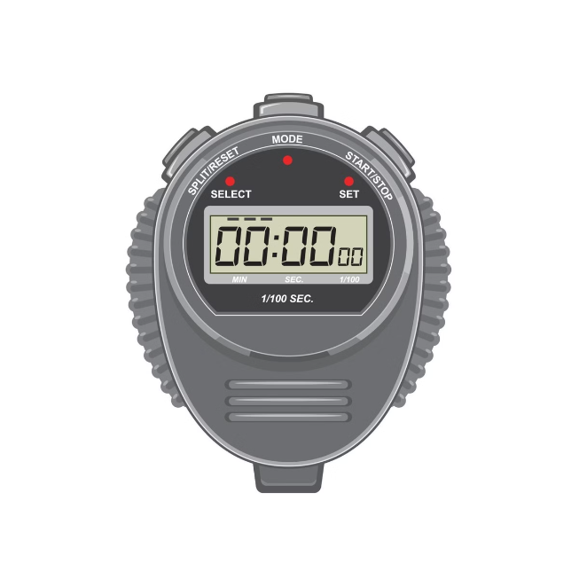
CSS Styling
Timer Display
Style the timer display to be clear, legible, and visually appealing.
Buttons
Design buttons with appropriate sizes, colors, and hover effects for user interaction.
Lap Display
Format the lap display for easy readability and organize lap times in a logical manner.

Slide 5
CSS STYLING
body {background-color: #2c3347; color: #ffffff; }
h1 { font-size: 48px; font-family: "Montserrat", sans-serif; font-weight: 200;
text-align: center; line-height: 59px;
padding: 0 64px; margin: 0; }
.stopwatch { display: grid; justify-items: center; grid-row-gap: 23px; width: 100%; padding-top: 25px; }
.circle { display: flex; justify-content: center; align-items: center;
height: 270px; width: 270px;
border: 2px solid; border-radius: 50%; }
.time { font-family: "Roboto Mono", monospace; font-weight: 300; font-size: 48px; }
.gold { font-weight: 900;
color: #f2c94c; text-shadow: 0 0 0px #fff, 0 0 50px #f2c94c; }
.controls { display: flex; justify-content: space-between;
width: 187px; }
button { cursor: pointer; background: transparent; padding: 0; border: none; margin: 0; outline: none; }
#playButton { display: block; }
#pauseButton { display: none; }

Slide 6

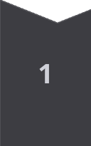
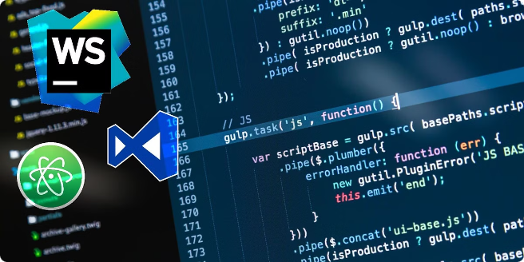
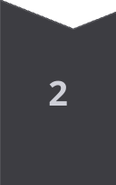
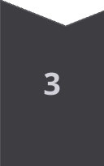
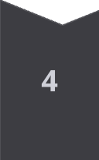
JavaScript Functionality
Start
Initialize a timer variable and start incrementing it at regular intervals, updating the timer display.
Pause/Resume
Toggle the timer's running state, pausing or resuming the time increment.
Reset
Stop the timer, reset the time variable, and clear the lap display.
Lap
Record the current time when the lap button is clicked, add it to the lap display.

Slide 7
CODE FOR SCRIPITNG
// Convert time to a format of hours, minutes, seconds, and milliseconds
function timeToString(time) { let diffInHrs = time / 3600000; let hh = Math.floor(diffInHrs);
let diffInMin = (diffInHrs - hh) * 60;
let mm = Math.floor(diffInMin);
let diffInSec = (diffInMin - mm) * 60;
let ss = Math.floor(diffInSec);
let diffInMs = (diffInSec - ss) * 100;
let ms = Math.floor(diffInMs);
let formattedMM = mm.toString().padStart(2, "0");
let formattedSS = ss.toString().padStart(2, "0");
let formattedMS = ms.toString().padStart(2, "0");
return ${formattedMM}:${formattedSS}:${formattedMS}; }
// Declare variables to use in our functions below
let startTime; let elapsedTime = 0; let timerInterval;
// Create function to modify innerHTML
function print(txt) { document.getElementById("display").innerHTML = txt; }
// Create "start", "pause" and "reset" functions
function start() { startTime = Date.now() - elapsedTime; timerInterval = setInterval(function printTime() { elapsedTime = Date.now() - startTime; print(timeToString(elapsedTime)); }, 10); showButton("PAUSE"); }
function pause() { clearInterval(timerInterval); showButton("PLAY"); }
function reset() { clearInterval(timerInterval); print("00:00:00"); elapsedTime = 0; showButton("PLAY"); }
// Create function to display buttons
function showButton(buttonKey) { const buttonToShow = buttonKey === "PLAY" ? playButton : pauseButton; const buttonToHide = buttonKey === "PLAY" ? pauseButton : playButton; buttonToShow.style.display = "block"; buttonToHide.style.display = "none";
}
// Create event listeners
let playButton = document.getElementById("playButton"); let pauseButton = document.getElementById("pauseButton"); let resetButton = document.getElementById("resetButton");
playButton.addEventListener("click", start); pauseButton.addEventListener("click", pause); resetButton.addEventListener("click", reset);

Slide 8

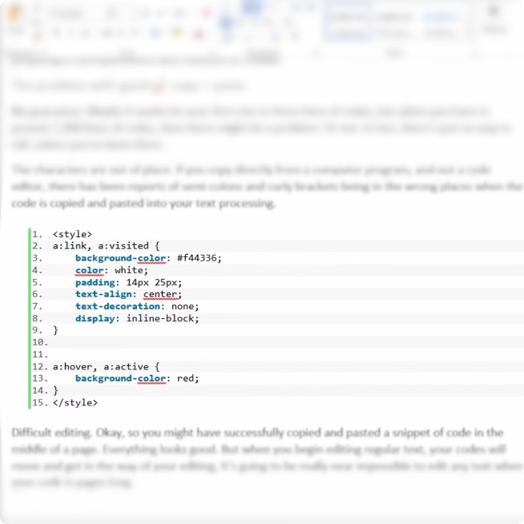
Timer Logic
1
Timekeeping
Use JavaScript's Date object to track the elapsed time with millisecond precision.
2
Interval
Use setInterval to repeatedly update the time display at a desired frequency, typically 10 milliseconds for smooth updates.
3
Formatting
Format the timer display to show minutes, seconds, and milliseconds, making it easy for users to understand.
4
Lap Calculation
Calculate lap times by subtracting the previous lap's time from the current time.

Slide 9


Event Handling
Event
Action
Start button click
Start the timer and update the display
Pause/Resume button click
Toggle the timer state and update the display
Reset button click
Stop the timer, reset the time, and clear the lap display
Lap button click
Record the current time, add it to the lap display

Slide 10
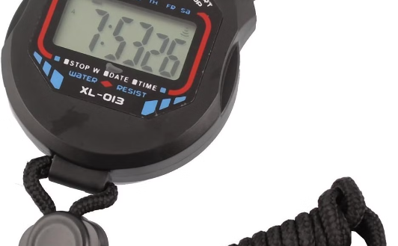
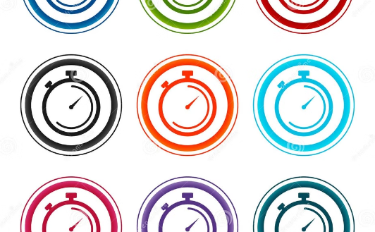
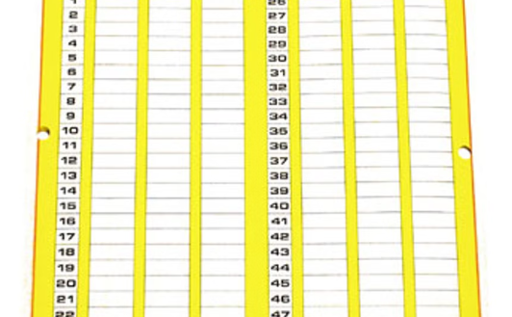
User Interface Design
Timer Display
Control Buttons
Lap Display
A prominent display showing the elapsed time, formatted for readability.
Start, Pause/Resume, Reset, and Lap buttons for user interaction.
A list or table showcasing recorded lap times, organized for clarity.

Slide 11





Testing and Refinement
Thorough Testing
Test the stopwatch application extensively to ensure it works accurately and reliably across different browsers and devices.
User Feedback
Gather user feedback to identify any areas for improvement in terms of usability, performance, and features.
Refine and Optimize
Based on testing and feedback, refine the stopwatch application's functionality, design, and performance.

